Slide 1

Yeadon Westfield Junior School
Progression in Fractions Policy
1

Slide 2
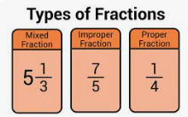
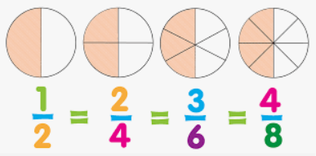
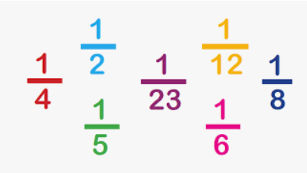
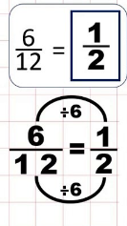

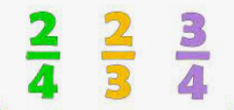
What are the parts of a fraction?
What are equivalent fractions?
A fraction has three parts. They are:
The Fraction bar which is the bar separating the two numbers.
The numerator which is the number above the fraction bar, that represents the amount of those parts.
The denominator which is the number below the fraction bar. That represents how many equal parts the whole is split into.
What is a fraction?
Equivalent fractions are two or more fractions that are equal. They represent the same number or value, despite having different numerators and denominators. You can make equivalent fractions by multiplying or dividing both top and bottom by the same amount.
Fractions are used to represent smaller pieces (or parts) of a whole. The parts might make up one thing, or more than one thing. Either way, altogether they make up what is called a whole.
What are the different types of fractions?
What is a unit fraction?
A unit fraction is any fraction with 1 as its numerator (top number), and a whole number for the denominator (bottom number).
What are mixed numbers and improper fractions?
What does it mean to simplify fractions?
When you have a whole number and a fraction side by side, like 1 ½ it’s called a mixed number. You can convert (change) this into a fraction, but the numerator will be bigger than the denominator. In this case, 3. This is called an improper fraction. 2
This means that we use the lowest possible numbers when we work out our fractions. We do this to keep things simple – it stops us from ending up with fractions made up of huge numbers (which can be confusing).
What is a proper fraction?
To simplify a fraction, divide the numerator and the denominator by the same amount.
What is a non-unit fraction?
When the fraction is less than a whole. The denominator is bigger than the numerator, it’s called a proper fraction.
A non-unit fraction is a fraction with a number greater than one as it’s numerator (top number) and a whole number for the denominator (bottom number).
2

Slide 3

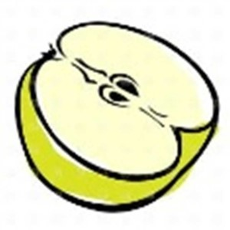
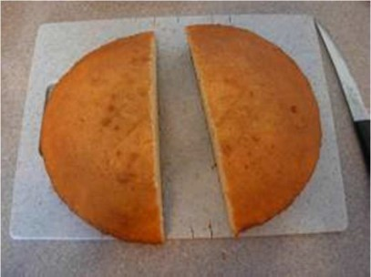
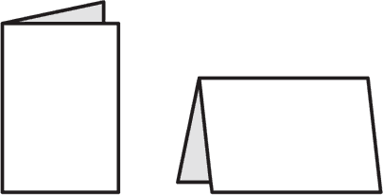
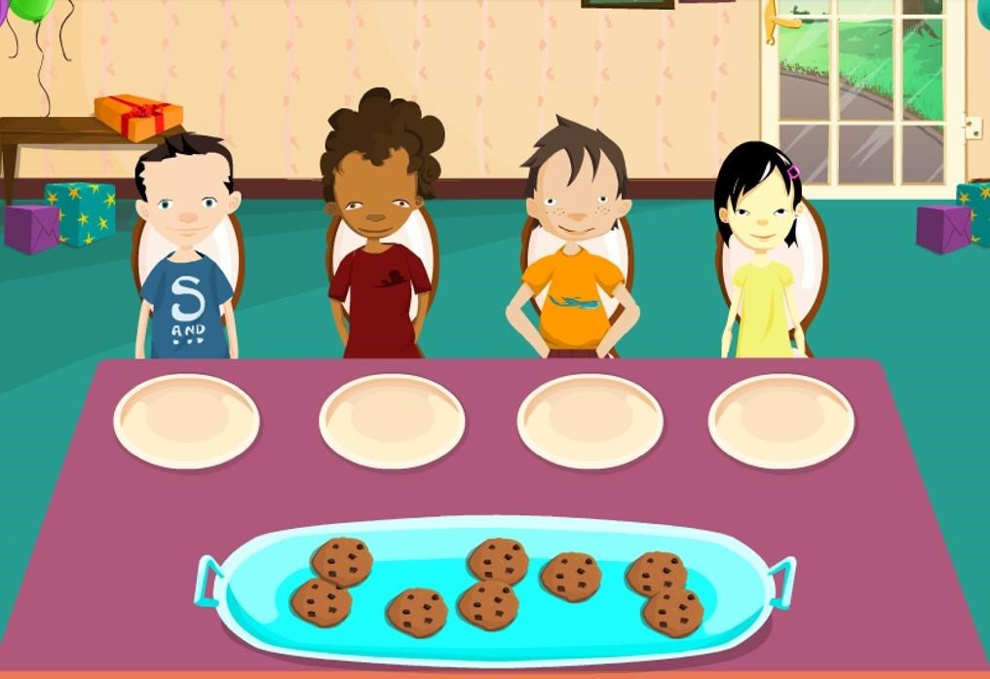
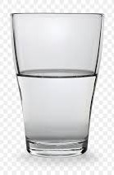
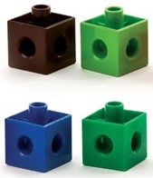
Fractions
How can we progress with fractions?
Using quantities and objects, children add and subtract two single-digit numbers and count on or back to find the answer. The children solve problems, including doubling, halving and sharing.
Concrete
Children learn how to share practically using objects. Children will check it is fair and that they all have the same amount (early division).
Children will have experiences ‘fractions’ in a practical way. The language used will include: one half, halves, equal, two parts, quarter, four parts, share, whole, split.
Children will use practical objects to develop their knowledge and awareness including some pictorial prompts.
3

Slide 4
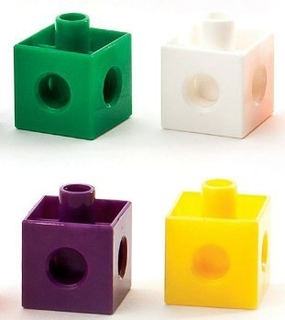

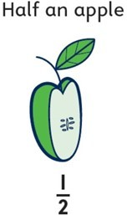
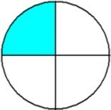
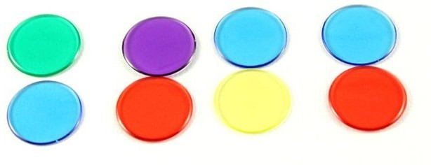
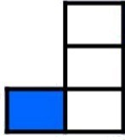
Year 1 Fractions
How can we progress with fractions?
Recognise, find and name a half as one of two equal parts of an object, shape or quantity.
Concrete Pictorial Abstract
Half of 10 =
Half of 8 =
½ of 4 =
Recognise, find and name a quarter as one of four equal parts of an object, shape or quantity.
Concrete Pictorial Abstract
A quarter of 8 =
A quarter of 20 =
¼ of 12 =
4

Slide 5
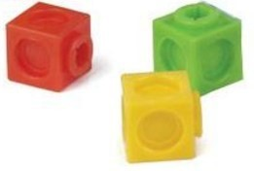
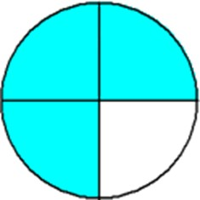

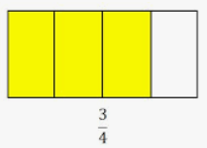
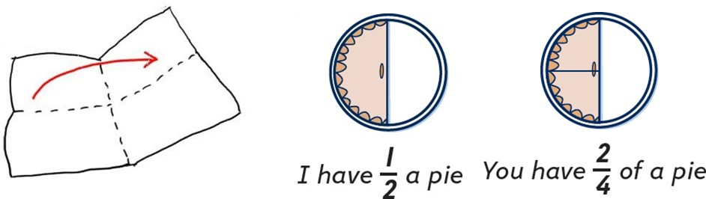
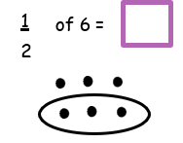
Year 2 Fractions
How can we progress with fractions?
Recognise, find, name and write fractions 1/3, 1/4, 2/4 and 3/4 of a length, shape, set of objects or quantity.
Concrete Pictorial Abstract
of 8 =
2
4
Half of 24 =
Write simple fractions and recognise the equivalence of 2 quarters and one half.
5

Slide 6

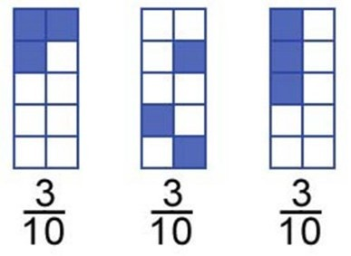

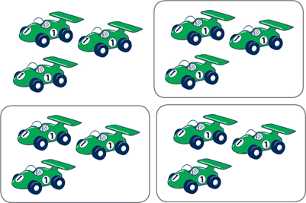
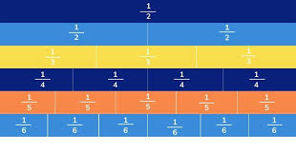
Year 3 Fractions
How can we progress with fractions?
Count up and down in tenths: recognise that tenths arise from dividing an object into ten equal parts and in dividing one-digit numbers or quantities by ten.
of 6 = 0.6 because 6 ÷ 10 = 0.6
Recognise, find and write fractions of a discrete set of objects: unit fractions and non-unit fractions and use fractions as numbers.
of 15 = 3 because 15 ÷ 5 = 3
of 15 sweets = 6 because 15 ÷ 5 = 3
and 3 x 2 = 6
We will say ‘how many 5s are there in 15? Now multiply this by the numerator.
6

Slide 7
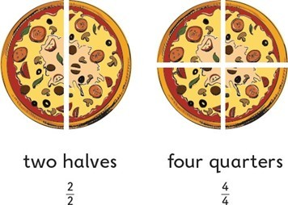
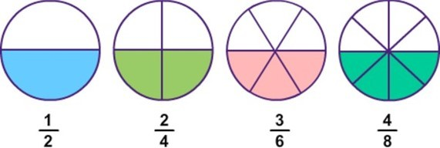
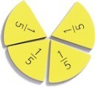
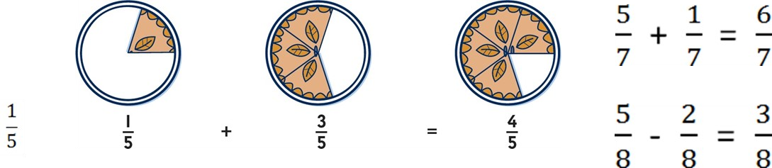
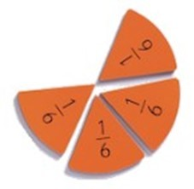

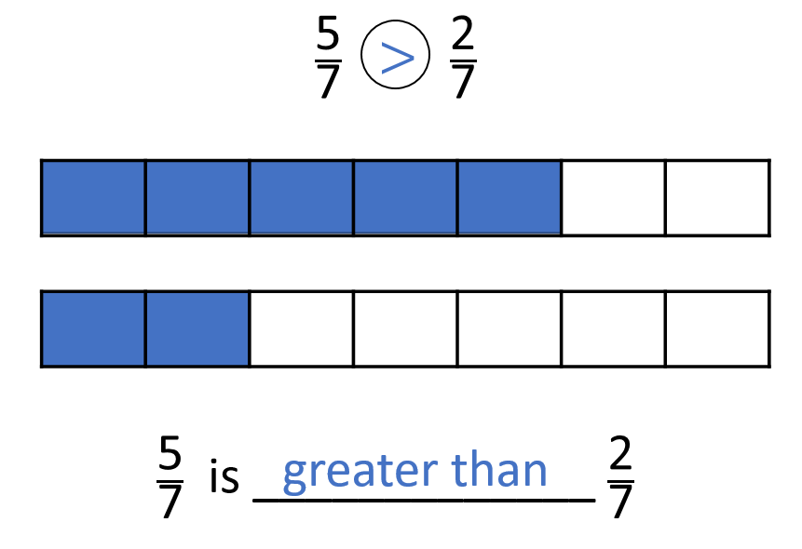

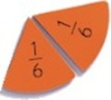


Recognise and show, using diagrams, equivalent fractions with small denominators.
Concrete Pictorial Abstract
Sam says that two quarters is the same as one half.
Is he correct?
How do you know?
Add and subtract fractions with the same denominator.
Concrete Pictorial Abstract
Compare and order unit fractions with the same denominator.
Concrete Pictorial
Abstract
7

Slide 8
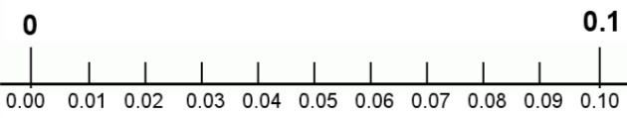
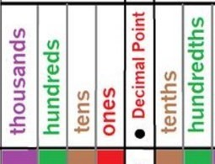


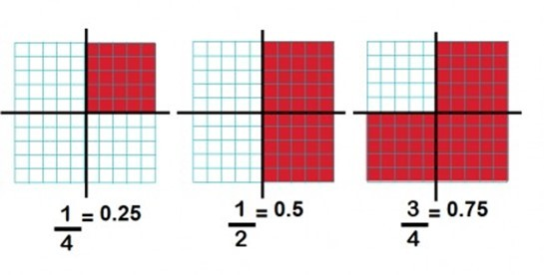
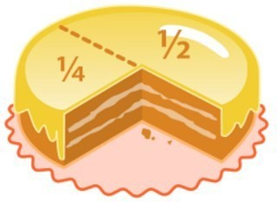
Year 4 Fractions
How can we progress with fractions?
Count up and down in hundredths: recognise that hundredths arise when dividing an object by one hundred and dividing tenths by ten.
Concrete Pictorial Abstract
because 60 ÷ 100 = 0.6
of 70 = 0.7
because 70 ÷ 100 = 0.7
Include – round decimals with one decimal place to the nearest whole number (year 5 have to 2 dp)
Compare numbers with the same number of decimal places up to two decimal places (year 5 similar)
1 hundredth = 0.01 =
Recognise and write decimal equivalences for 3/100, 1/2, 1/4, 7/100 and 3/4
Concrete Pictorial Abstract
= 0.5
0.5
0.25
= 0.25
= 0.75
8

Slide 9

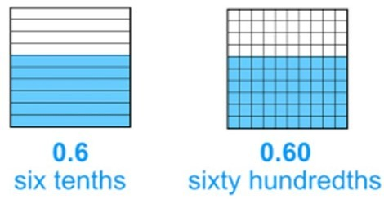
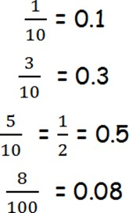


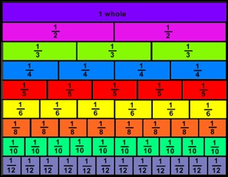


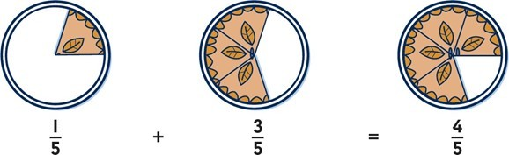
Recognise and write decimal equivalents of any number of tenths or hundredths.
Concrete Pictorial Abstract
of the chocolate = 0.1
Recognise and show, using diagrams, families of common equivalents.
=
Concrete Pictorial Abstract
Add and subtract fractions with the same denominator.
Concrete Pictorial Abstract
of a whole pizza.
Sam eats
How much does he have left?
Lucy and Ben both eat three eighths of cake.
How much have they eaten altogether?
10

Slide 10
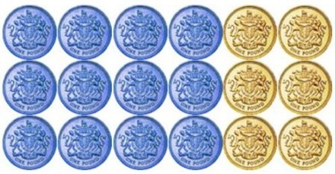
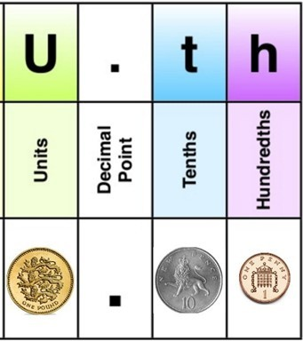
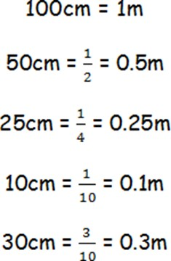
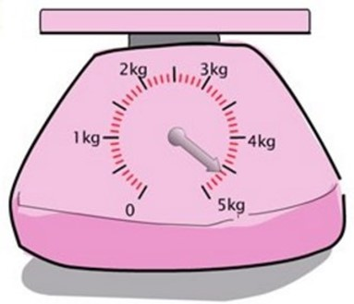
Solve problems involving increasingly harder fractions to calculate quantities, and fractions
to divide quantities, including non-unit fractions where the answer is a whole number.
Concrete
Pictorial
Abstract
of £18
£18 ÷ 3 = £6
£6 x 2 = £12
Solve simple measure and money problems involving fractions and decimals to two decimal places.
Concrete Pictorial Abstract
O
Ones

Slide 11


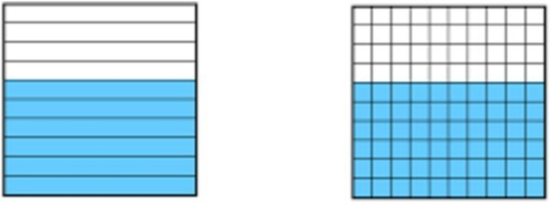
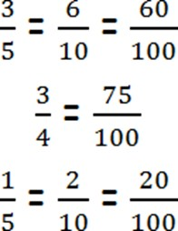

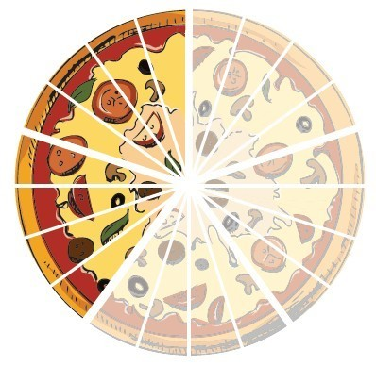
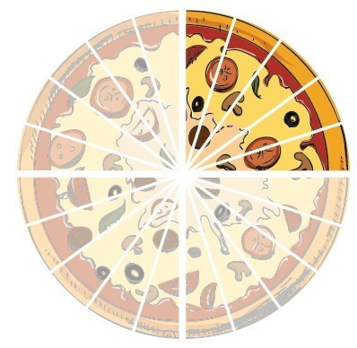
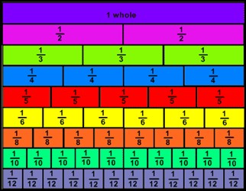
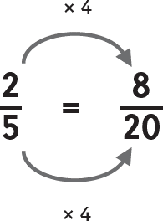
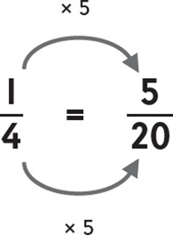




Year 5 Fractions
How can we progress with fractions?
Identify, name and write equivalent fractions of a given fraction, represented visually, including tenths and hundredths.
Concrete Pictorial Abstract
=
Compare and order fractions whose denominators are all multiples of the same number.
Concrete Pictorial Abstract
>
>

Slide 12










Recognise mixed numbers and improper fractions. Convert from one form to the other
and write mathematical statements >1 as a mixed number.
Concrete Pictorial Abstract
<
=
because 7 ÷ 2 = 3 with 1 half left over.
=
because 2 x 3 = 6 with 1
third left over to add.
Add and subtract fractions with the same denominators and denominators that are multiples of the same numbers.
Concrete Pictorial Abstract
+
=
- =

Slide 13










Multiply proper fractions and mixed numbers by whole numbers, supported by materials
and diagrams.
Concrete Pictorial Abstract
Multiply a proper fraction by a whole number:
X 6 =
altogether
Change to a mixed number:
=
6 lots of
Recognise and use altogether thousandths and relate them to tenths, hundredths and decimal equivalents.
Concrete Pictorial Abstract
67.153
How many thousandths does this number have?
How many thousandths do you need to add to it to make it 67.16?

Slide 14



Recognise % symbol and understand the meaning: write % as a fraction, decimal and percentage
Concrete Pictorial Abstract

Slide 15




















Year 6 Fractions
How can we progress with fractions?
Add and subtract fractions with different denominators and mixed numbers using the
concept of equivalent fractions.
Concrete Pictorial Abstract
+
=
=
=
Compare and order fractions including fractions >1
Concrete Pictorial Abstract
>
>
>

Slide 16












Concrete Pictorial Abstract
Use common factors to simplify fractions; use common multiples to express fractions
in the same denomination.
= =
Multiply simple pairs of proper fractions, writing the answer in its simplest form
Concrete Pictorial Abstract

Slide 17










Concrete Pictorial Abstract
Recall and use equivalences between simple fractions, decimals and percentages including
in different contexts.
John scored
Which would you prefer 75% or
of a pie?
Hannah scored 40%. Who scored more?
John = =50%
Hannah = 40%
One paving slab is 0.3m long and another
is of a metre. Which is longer?
75%
= 0.25m
0.3m is larger than 0.25m
Divide proper fractions by whole numbers.
Concrete Pictorial Abstract

Slide 18







Associate fractions with division and calculate decimal fraction equivalents.
3 slices of pie ‘out of 8
0.25
0.25
3 ‘out of’ 8 is the same as 3 ‘divided by’ 8
0.25
0.25
0 . 3 7 5
So 8 3 .
3₀ 6₀ 4₀

