Slide 1
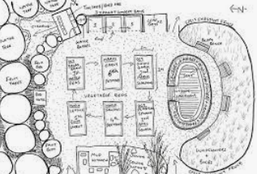
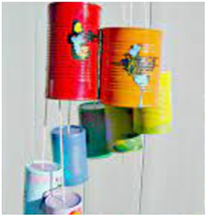
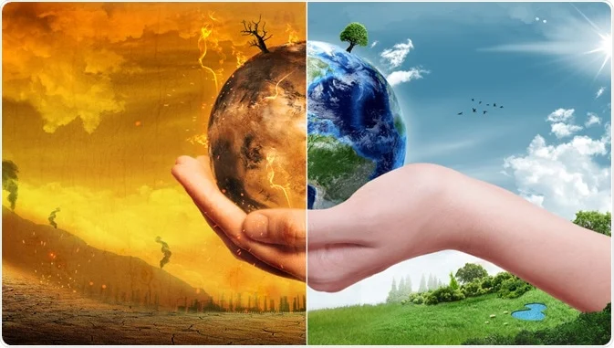
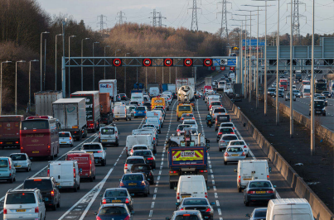
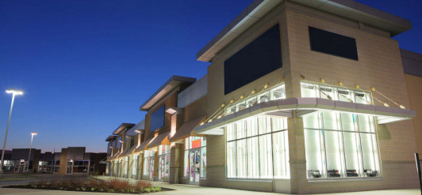
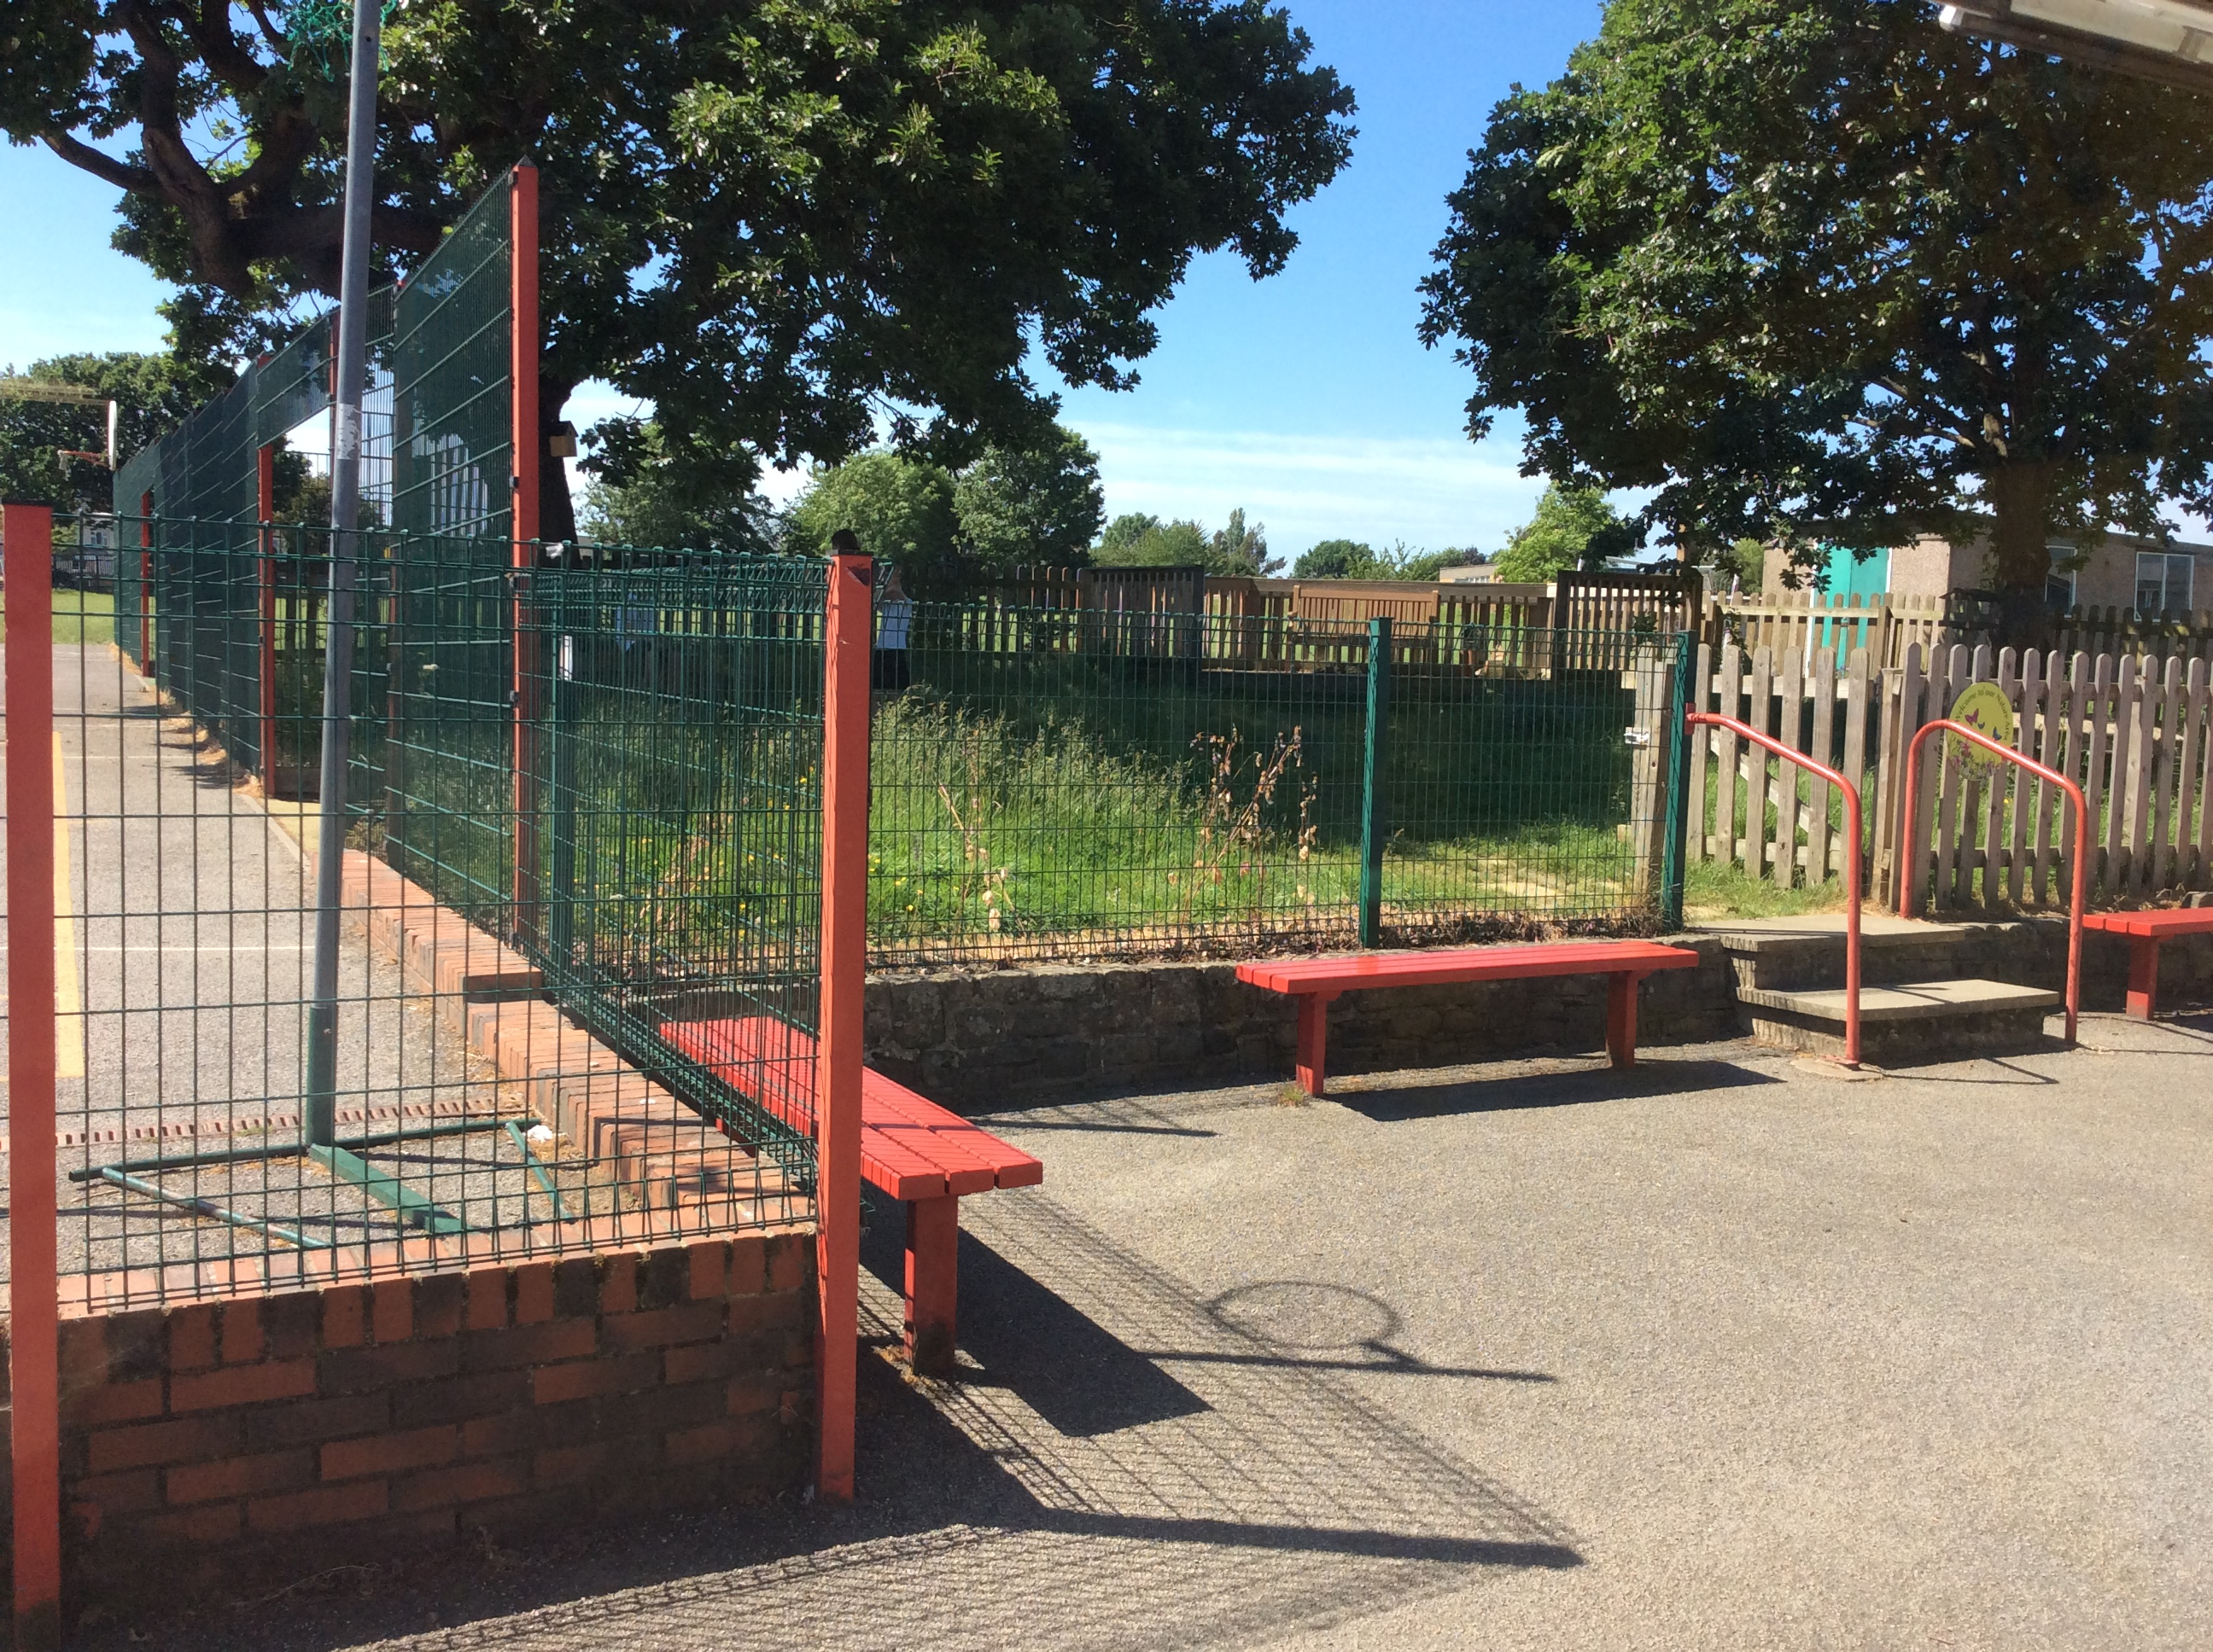
Climate Change – Year 3
Lesson 2
Climate change
How can people take action against climate change?
Lesson 3
Climate change
What are some positive steps we can do to reduce climate change?
Lesson 4
Geographical skills and fieldwork
What are the human and physical features of our school grounds?
Lesson 5
Geographical skills and fieldwork
What is special about our school grounds and what would you change?
.
Lesson 6
Geographical skills and fieldwork
Can you map Jack’s garden?
Lesson 7
Muddy Puddle project:
Improving our school grounds:
Make our own dream catchers and windchimes.
Lesson 1
Climate change
What is climate change, what causes it and how it affects the planet?
What will we be learning about over the coming weeks?

