Slide 1
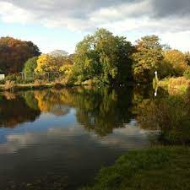
Water in our world – Year 6
Lesson 1
Water in our world
What are the problems with bottled drinking water? Are there sustainable alternatives?
Lesson 2
Water in our world
Why do people in developing countries have limited access to water?
Lesson 3
Water in our world
How can we make sure everyone has clean, safe water?
Lesson 4
Geographical skills and Fieldwork
What are the differences between the human features of Nunroyd Park and Tarnfield Dam?
Lesson 5
Geographical skills and Fieldwork
What are the differences between the physical features of Nunroyd Park and Tarnfield Dam?
Lesson 6
Lesson 6
Water
Muddy Puddle Project
Plan a sustainable area that has a balance of nature, varied habitats and gives back to others
What will we be learning about over the coming weeks?

