Slide 1

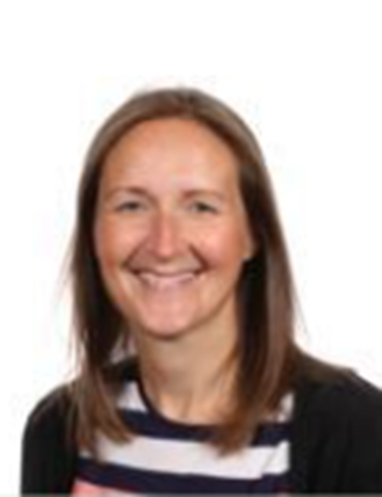
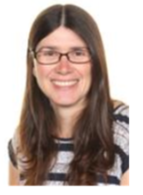
Welcome to 5/6 Appletreewick
Mrs Place (HLTA)
Covers Mrs C Wed am for Curriculum cover. Mrs Place will teach spellings and arithmetic.
Mrs Clarkson
Appletreewick Class Teacher

Slide 2
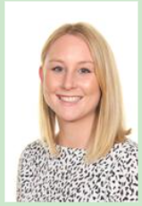
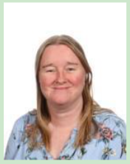
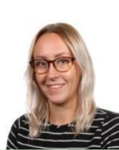
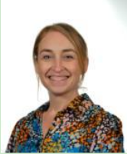
Other adults who may teach 5/6 Appletreewick
Sophie Johnson
Teacher
Hannah Lockwood
Teacher
Helen Swallow
Teacher
Charlotte Farnell
HLTA

Slide 3
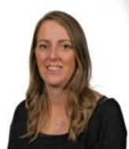
Support staff in 5/6 Appletreewick
Stacey Law
Learning Support Assistant
Vicky Hillyard
Learning Support Assistant
Justine Langley
Learning Support Assistant

Slide 4

When do we need to bring things in?
Monday – Bring weekly homework tasks for Maths and English back to school.
Tuesday -
Wednesday – Spelling test. Wear PE kit to school.
Thursday - Reading records to school.
Friday – Reading record goes home

Slide 5
School uniform/ Equipment
Please note that the school hoodie is an item of outdoor clothing/PE and is not to be worn in place of a sweatshirt/jumper or cardigan in class.
We encourage that no jewellery of any kind should not be worn at Westfield Juniors, with the exception of stud earrings. Please speak to Mrs Piotrowicz if you have a specific request or query about the wearing of jewellery in school.
All children must have a pair of indoor shoes.
Also children should also have a water bottle in school with their name on.
All children are provided with pencil cases.

Slide 6
What PE kit should I wear? What happens if I forget my kit?
Indoor PE kit is a plain, white t-shirt and black shorts/cycling shorts.
Outdoor PE kit can be a plain (dark coloured if possible) tracksuit. A plain hoodie/school hoodie can also be worn. Trainers MUST be worn for PE outside. All jewellery must be removed for PE lessons (stud earrings may be taped over or removed) including watches. Long hair needs to be tied up.
Forgetting PE kit
Children should have the correct PE kit for every PE lesson.
If children forget regularly forget to come in their kit, a phone call will be made to parents to see if we can support in any way.

Slide 7
When do I get homework?
Homework includes reading and a piece of maths and English weekly.
Spelling
Your child will have a set day when they are tested on their spellings. We practise spellings every day in school so children do not bring home a spelling practice book. If you wish to practise with your children at home, you can request a yellow book to practise in but it does not need to come back into school. Weekly spellings can be found on your child’s year group page on the website.

Slide 8
Timestables
Timestables are practised three times a week and tested twice a week using Timestables Rockstars (an online timestables programme) however, it is beneficial for your child to practise at home.
We encourage your child to take part in Timestables Rockstars Garage activities at home for 30 minutes a week. If your child completes this, your child will receive a token to put into a year group jar. The class with the most tokens at the end of the year, will earn a reward.

Slide 9


English and Maths homework
Completed homework should be checked by parents and will then be self marked by the children on a Monday. Next week, children will bring home two homework books, a 10-minute weekly workout maths book and a 10-minute weekly workout English book. Children will complete one workout from each book, each week.
Parents can request additional homework resources if they wish and Year 6 may receive additional work as we build to the SAT tests in May 2025.
Homework is expected to be brought into school every Monday morning. If a child repeatedly forgets to bring their homework in on a Monday, we will ask them to go to Homework Club with Mrs Stokey on a Tuesday so she can help support them with their homework and ensure it is completed on time.

Slide 10


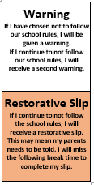
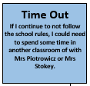
The Westfield Rainbow
All children start on green at the start of every day.
If they misbehave, they are told they are on a warning for choosing not to follow one of the school rules.
If the behaviour continues, they are told that are on a second warning as they are still choosing to not follow one of the school rules and if the behaviour continues, they may receive a restorative slip.
If the behaviour still continues, they will receive a restorative slip which they will complete at break time with a member of staff. If the behaviour continues. A phone call to parents will be made.
If the behaviour still continues, the child will move to another class for time out.
If children show brilliant behaviour, they can move to purple and will come home with a sticker saying 'I've been in purple, ask me about my day!'
If a child has shown exceptional behaviour, they move onto a golden star. 5 golden stars are chosen, one at the end of each day. These children are celebrated in the Friday assembly and the school newsletter.

Slide 11
Children’s Work
Each week we will celebrate work that the children have produced and a child from each class will receive a special headteacher sticker. These pieces of work will be displayed on the display board underneath the shelter on the playground. Please have a look!

Slide 12

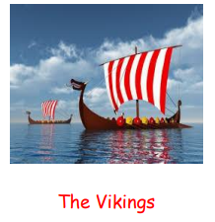

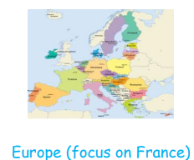
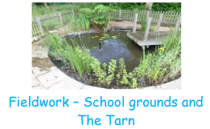

What topics will I study?

Slide 13
What trips will I go on?
14th November – Mobile police museum linked to World War II.
The little suitcase workshop – date TBC
Eden Camp – Autumn term TBC.
Year 6 will go to Herd Farm on the residential – Miss Swallow is in conversations with Herd Farm about how this will be organised but it will take place during the first week in July. Details to follow ASAP.

Slide 14
Communication
Our website is the main way to find out information at school so please check it regularly.
All the weekly newsletters are on the website. The newsletter has all the key information for the week and key dates. All the exciting subject work we do can be found on our Curriculum Pages. Here you will see videos and pictures of your children. Links to any new website updates are included on the weekly newsletter.
Newsletters are found on the homepage.
Homework and spellings can also be found in every year group's page.

Slide 15
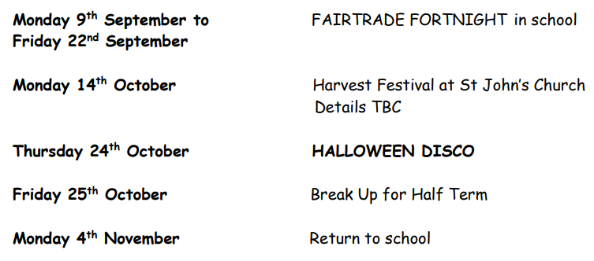
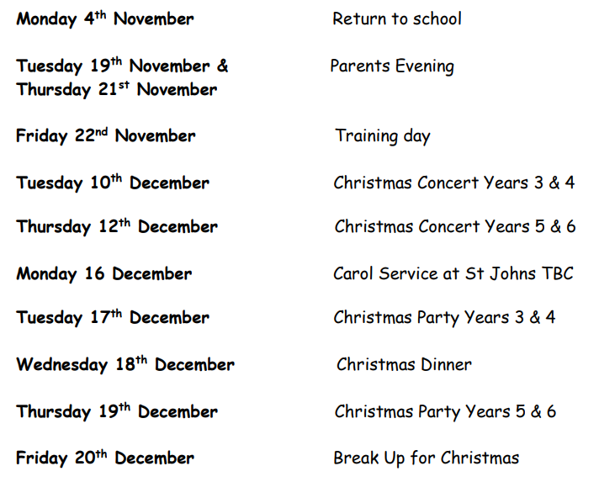
Any key dates I need to
know for this term?
All key dates until Christmas are on the newsletter. The Harvest Festival and Carol Service at St Johns Church have been confirmed. Parents can attend this, look out for emails with regards to these events.

Slide 16
Important allergy information
Please note, it is extremely important that no nut and sesame seed products are brought into school.
Children should also only have healthy snacks at break time.

Slide 17
Any questions?

