Slide 1

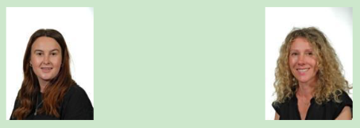
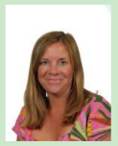
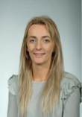
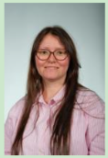
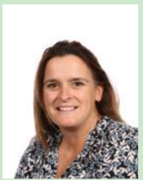
Welcome to Year 3
Gemma Pound
Teacher 3B
Caroline Scargill
Teacher 3L
Alison Jones
Learning Support Assistant, Deputy DSL & Twilight Owls Playworker
Vicky Hillyard
Learning Support assistant
Karolina Nowaczyk
Learning Support assistant
Rosie Stokey
Learning Mentor

Slide 2

When do we need to bring things in?
Monday – bring weekly English and Maths homework in (not till after half term)
Tuesday – PE Kit
Wednesday – Take home book bags
Thursday -
Friday – PE Kit

Slide 3
Uniform and equipment
Please note that the school hoodie is an item of outdoor clothing/PE Kit and is not to be worn in place of a sweatshirt/jumper or cardigan in class.
We encourage that no jewellery of any kind should not be worn at Westfield Juniors, with the exception of stud earrings. Please speak to Mrs Piotrowicz if you have a specific request or query about the wearing of jewellery in school.
All children must have a pair of indoor shoes.
Also children should also have a water bottle in school with their name on.
All children are provided with pencil cases.

Slide 4
What PE kit should I wear?
What happens if I forget my kit?
PE kit is a plain, white t-shirt and either black shorts/leggings/black jogging bottoms. A red school hoodie can also be worn for outdoor PE during the cold weather. Trainers must be worn for PE. All jewellery must be removed for PE lessons including watches. If children cannot remove their earrings independently then it is advised that they come to school on their PE day without earrings in. Long hair needs to be tied up.
Forgetting PE kit
Children should have the correct PE kit for every PE lesson.
If children regularly forget to bring their kit, a phone call will be made to see if we can support in any way.

Slide 5
When do I get homework?
Homework includes reading, a 10-minute maths book and a 10-minute spelling and vocabulary book.
Year 3, these homework books will start to come home after October half term.
Spelling
Children will practise spellings in school. We will not be carrying out weekly spelling tests.

Slide 6
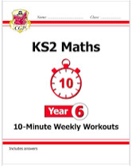

English and Maths homework
Completed homework should be checked by parents.
Homework is expected to be brought into school every Monday morning. If a child repeatedly forgets to bring their homework in, we will ask them to go to Homework Club with Mrs Stokey on a Tuesday so she can help support them with their homework.

Slide 7
Timestables
Timestables are practised 4 times a week in school and tested regularly by the teachers and on Timestables Rockstars (an online timestables programme). However, it is beneficial for your child to practise at home. All children are working on an individualised programme so please ask them currently which table they are practising.
We encourage your child to take part in Times tables Rockstars Garage activities at home for 30 minutes a week. If your child completes this, they will be rewarded with a certificate in our award assembly. Please email/ring the office to request your child’s login details should you need them.

Slide 8
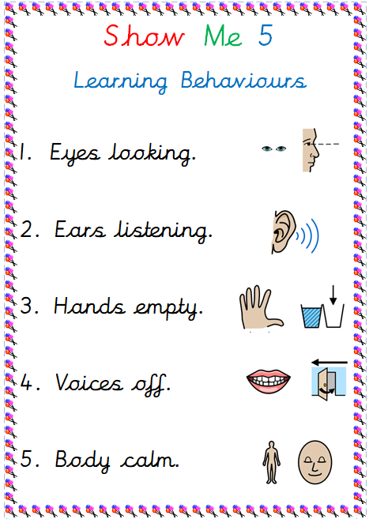

Behaviour at YWJS

Slide 9

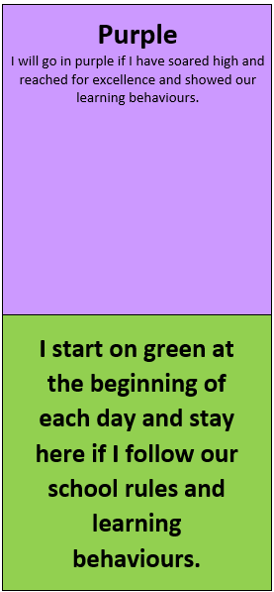
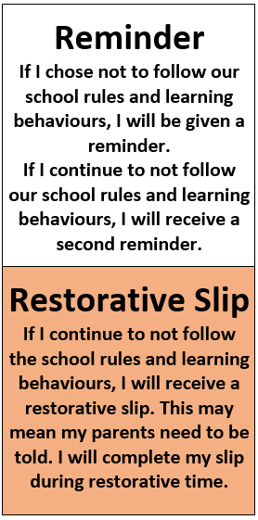
The Westfield Rainbow
All children start on green at the start of every day.
If they are not following the school rules or learning behaviours, they are given a reminder about their behaviour.
If they continue to not follow one of the school rules or learning behaviours, they are given a second reminder.
If they still continue to not follow one of the school rules or learning behaviours, they will receive a restorative slip which they will complete just before the end of the day. You may receive a phone call.
If children show brilliant behaviour, that they are following the school rules and showing our learning behaviours, they can move to purple and will come home with a sticker saying 'I've been in purple, ask me about my day!'
If a child has shown exceptional behaviour, they move onto a golden star. 5 golden stars are chosen, one at the end of each day. These children are celebrated in the Friday assembly and the school newsletter.

Slide 10
Children’s Work
Each week we will celebrate work that the children have produced and a child from each class will receive a special Headteacher sticker. These pieces of work will be displayed on the board underneath the shelter on the playground.
Please have a look!

Slide 11

Year 3 Topics

Slide 12

Communication
Our website is the main way to find out information at school so please check it regularly.
All the weekly newsletters are on the website. The newsletter has all the key information for the week and key dates. All the exciting subject work we do can be found on our Curriculum Pages on the website. Here you will see videos and pictures of your children. Links to any new website updates are included on the weekly newsletter. Newsletters are found on the homepage and are emailed out each week to all parents. Homework timetables can also be found on every year group's page.
It is vital that the contact information we have for you is up to date especially mobile numbers and email addresses as we send all our information either via text or email.

Slide 13

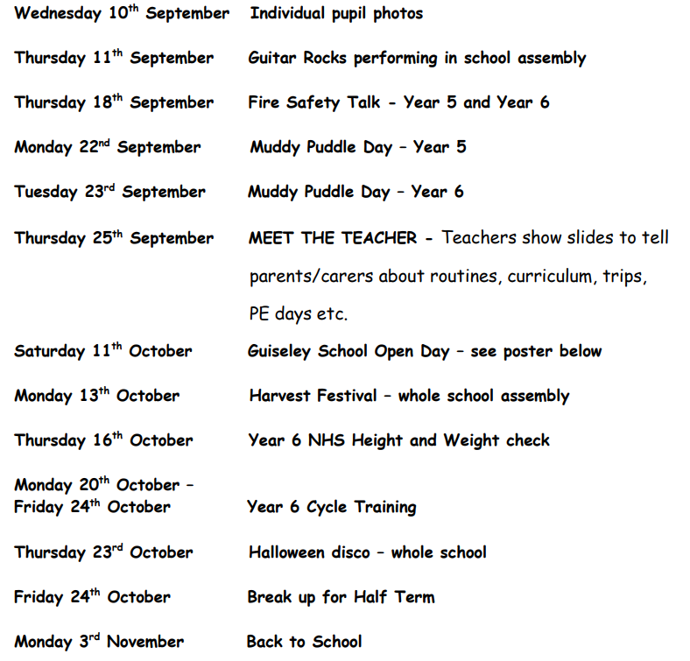
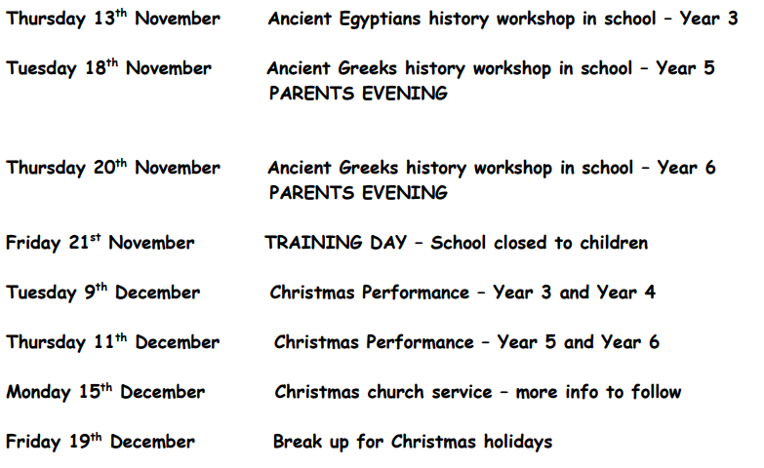
Any key dates I need to
know for this term?
All key dates until Christmas are on the newsletter. The Harvest Festival and Carol Service at St John’s Church may be on different dates due to availability at the church. We will let you know.

Slide 14
Important allergy information
Please note, it is extremely important that no nut, mustard and sesame seed products are brought into school.
Children should also only have healthy snacks at break time.

Slide 15
Any questions?

