Slide 1

Welcome
Headteacher- Lisa Piotrowicz
SENCO- Rebecca Whitaker
-Integrated Services Leader-Aireborough Family Services-Jemima Lutter

Slide 2
Equality Act 2010
… schools cannot unlawfully discriminate against pupils because of their sex, race, disability, religion or belief or sexual orientation.
… for children with a disability or SEN, the school must make ‘reasonable adjustments’…
Children and Families Act 2014
Section 66 of the Children and Families Act 2014 says:
“If a registered pupil or a student at a school or other institution has special educational needs, the appropriate authority must, in exercising its functions in relation to the school or other institution, use its best endeavours to secure that the special educational provision called for by the pupil’s or student’s special educational needs is made.”
SEN code of practice 2021
A pupil has SEN where their learning difficulty or disability calls for special educational provision, namely provision different from or additional to that normally available to pupils of the same age.

Slide 3
RWI phonics
Lego Therapy
Thrive sessions
Nessy intervention
Adaptations to spellings
Adaptations to behaviour policy
Adaptations to uniform – sensory needs
Adaptations to expectations for assembly / hall at lunch time (different times/noise/smells)
Team around the child – trusted adult
Support from:
AET, ICAN
STARS
SENIT
Mindmate
Cluster therapy
Speech and language therapy
Educational Psychologist
Guiseley Community Foundation
Reasonable adjustments that we make:
Visual timetables
Now and next boards
Start and finish boxes
Talking mats
Home/school diary
Fidgets / chewy toys
Ear defenders
Chair bands
Sensory boxes
Movement breaks
Chunking / small steps
Increasing processing time
Support from TA in class
Sensory room
Quiet area
Pre teaching
Checklists
Writing scaffolds
Coloured overlays
Regular check-ins
Meet and greet
De-brief
Zones of regulation
Emotional rating scales / cards
Social stories
Comic strip conversations
Adaptive environment
Interventions
Ability to use ipad / scribe
Individual timetables
Sensory circuits
Use of gestures/non verbal cues
Timers
Adaptations to homework
Mindfulness activities to reduce anxiety: colouring, cutting, drawing
Assisted technology
B Squared small step assessment

Slide 4
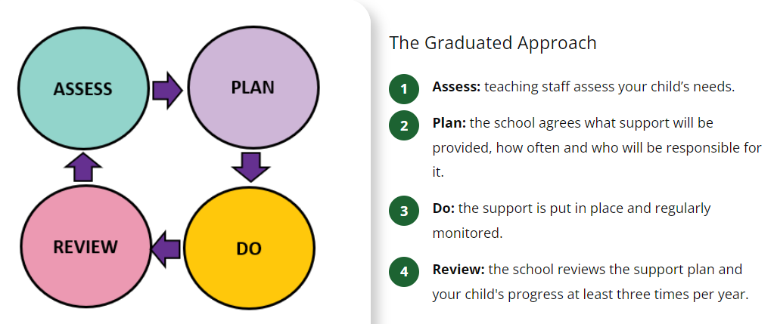
Graduated Approach
-There is no statutory duty to provide a graduated approach, although this is recommended in the -SEND Code of Practice.
-The graduated approach is a cyclical and ongoing process
-There are four stages.
-This can be reviewed with parents termly where necessary

Slide 5
EHCP’s
“the local authority should consider whether there is evidence that despite the early years provider, school or post-16 institution having taken relevant and purposeful action to identify, assess and meet the special educational needs of the child or young person, the child or young person has not made expected progress”-paragraph 9.14 SEN and disability Code of Practice 2015
Parents should request an EHC assessment if “they believe that the school or college is not able to provide the help and support which is needed”-IPSEA

Slide 6
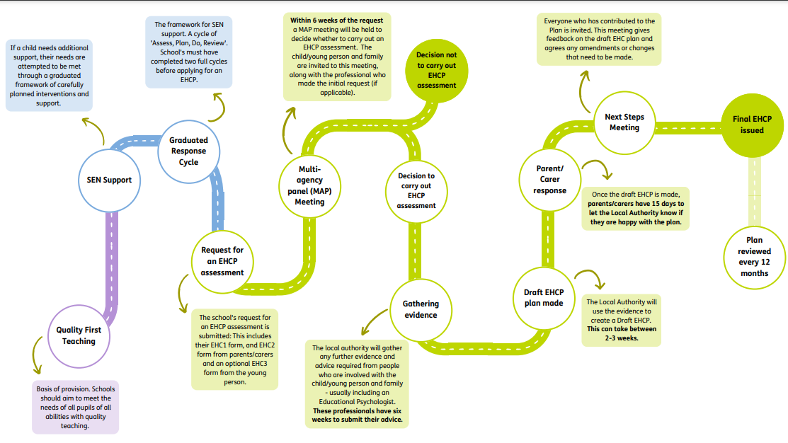
EHCP timeline

Slide 7
EHCP application
Applying for an EHCP requires gathering and collating of evidence from across school and other agencies where appropriate.
Groups prioritised by SENSAP
Time frames-Up to a year or more currently.
EHC2-Parents right to apply-challenges
EHCP’s don’t always transform the support

Slide 8
Funding
FFI funding is changing
This will only increase the numbers of EHCP’s being applied for
Anyone receiving EY/FFI will (eventually) get an EHCNA
Schools are being asked not to submit any new requests for assessment
Leeds for Learning-For latest updates.
EHCP’s and FFI are not golden tickets to support.

Slide 9
Right To Choose
Mindmate waiting list 4-10 years plus
RTC has been available since 2018
Has its own challenges

Slide 10
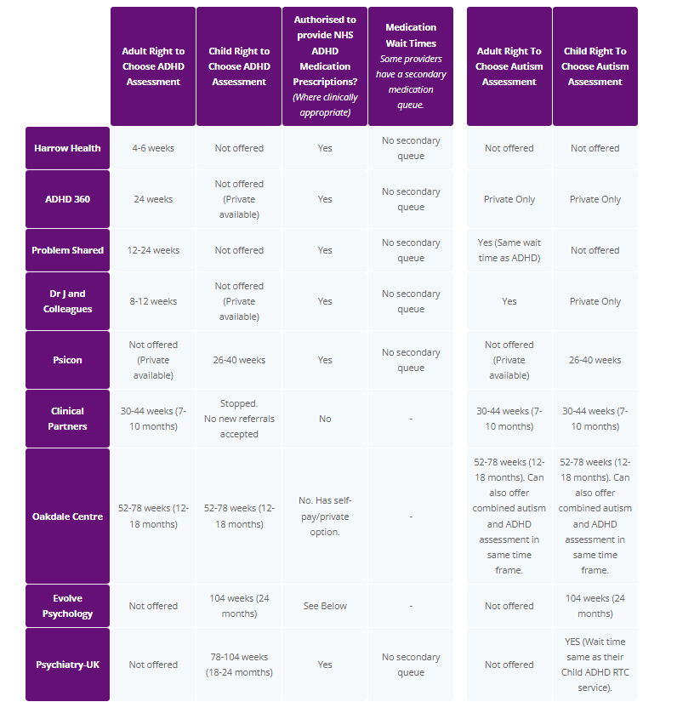

Slide 11
Need for diagnosis
A diagnosis is not a description of need nor is it a pathway to support.
Schools do not necessarily put more support in place once a diagnosis is sought. Same can be said for EHCP’s, plans can have provision outlining support available through graduate approach-anything “different than” or “additional to” general provision for the neurotypical cohort.
Diagnosis is not required for applications for DLA, EHCP, graduated approach, needs assessment, CSWS, Carers assessment for parents/carers.
6,000 children a year are born with an undiagnosable disability. (Great Ormond Street Hospital)

Slide 12
What does your child need?
Support in school/home:
Graduated approach
Reasonable adjustments
Passport/IEP
Communication
Life skills
Understanding
Consistency
Awareness
Resources

Slide 13
Signposting
ICAN
Little Hiccups
S+B
Sensory world
Carers Leeds
SNAPS
Zigzag
Keeping safe
STARS
Minded
PBS
Max card
Facebook SEN groups
Scope activities for all
IPSEA
SENDIASS
SENIT
Training
Makaton
Boardmaker

